Slide 1

Game Development in Unity
HackBI 2026

Slide 2



What is Unity?
Free game engine
Used by both indie studios and AAA developers
3D and 2D games
C# programming language

Slide 3
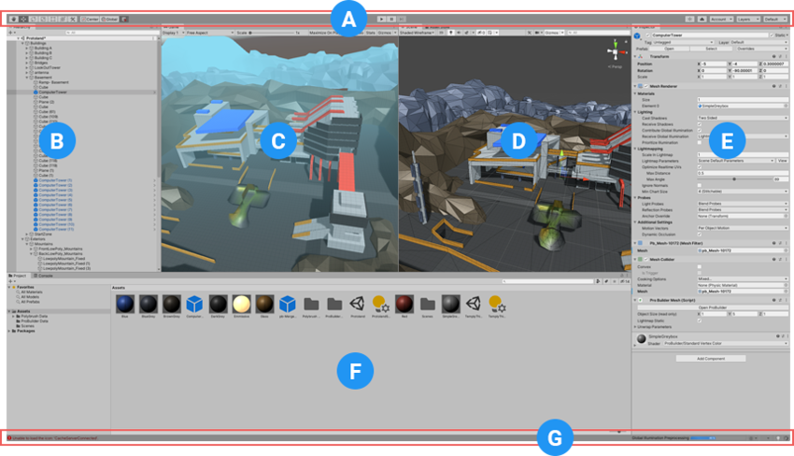
The Unity Interface
(A) The Toolbar
(C) The Game View
(D) The Scene View
(E) The Inspector Window
(F) The Project Window
(G) The Status Bar

Slide 4
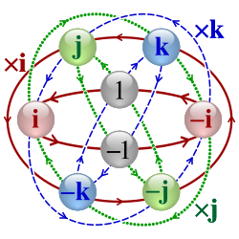
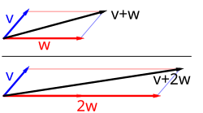
Useful Concepts for Unity Development
Vectors
Objects
Quaternions
Representations of direction and distance
Three dimension components and/or a magnitude
If you’ve taken physics, you know these
Anything that exists within the game/scene
Have coordinates and can be given components
Unity’s default angle representation
Technically 4-dimensional
Just use Quaternion.euler()

Slide 5
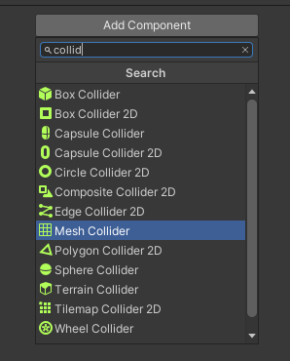
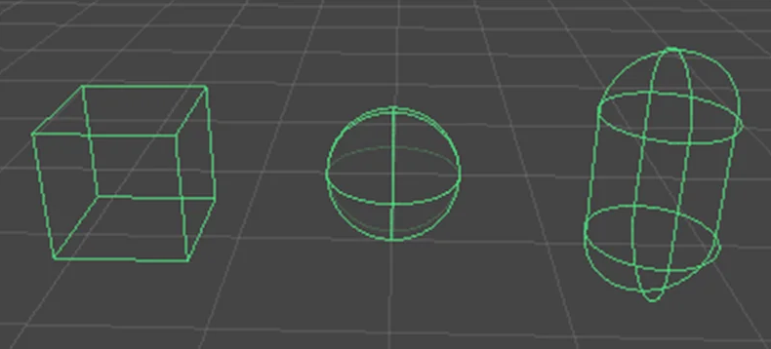
Useful Concepts for Unity Development (Continued)
Components
Colliders
Rigidbodies
Capabilities that can be added to an object
Include colliders, physics systems, custom scripts, texturing systems
Allow for detecting and preventing intersections between objects
Two types: solid and trigger
Tell an object to obey physics
Very configurable, and can be configured by scripts during gameplay

Slide 6
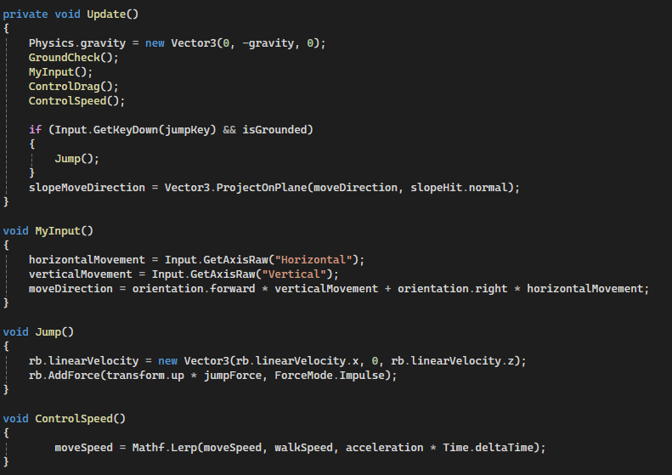
C# Programming
Most of any game in the Unity engine is made up of custom scripts, written in the C# programming language.

Slide 7
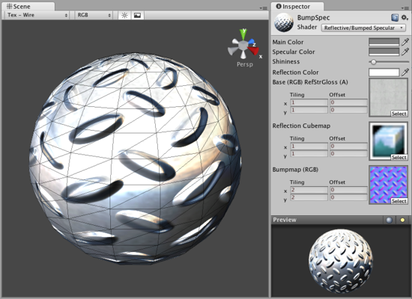
Unity Graphics
Unity has two different graphics systems - 2D and 3D.
3D -
Materials
Shaders
2D -
Sprites
Canvas
Text/UI

Slide 8
Further Resources
Brackeys
Unity Beginner Tutorials
How to Program in C#
Unity Official Documentation
C# Syntax
Unity Learning Tracks
StackOverflow

Slide 9
Thank you
Do you have any questions?
youremail@freepik.com
+00 000 000 000
yourwebsite.com
Please keep this slide for attribution

